Slide 1
Namespaces

Slide 2


Module Overview
In this module, you will learn about:
XML Namespaces
Working with Namespaces Syntax

Slide 3


Lesson 1 – XML Namespaces
In this first lesson, XML Namespaces, you will
learn to:
Identify the need for a namespace.
Define and describe namespaces in XML.

Slide 4


Duplicate Element Names
It allows developers to create their own elements
and attributes for their own projects.
Developer has to ensure the uniqueness of the element names and attributes in a document.

Slide 5


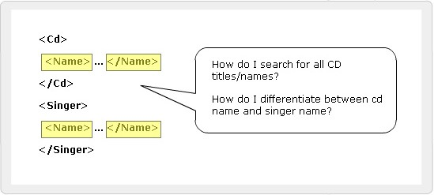
Consequences of Duplicate Element Names
Name conflicts are inevitable from different
developers.
It is difficult for the browser to distinguish a conflicting element.

Slide 6

Namespaces
Elements are distinguished by using namespaces.
A namespace is a collection of names.
Namespaces allow the browser to:
Combine documents from different sources
Identify the source of elements or attributes

Slide 7

Lesson 2 – Working with Namespaces Syntax
In this last lesson, Working with Namespaces
syntax, you will learn to:
Explain the syntax for XML namespaces.
Discuss attributes and namespaces.
Discuss how to use default namespaces.

Slide 8


Prefixing element names
Prefixes in element names provide a means to
prevent name collisions.
Code Snippet
<CD:Title> Feel </CD:Title>
and
<Book:Title> Returning to Earth </Book:Title>.
In the above example, both CD and Book are namespace prefixes.

Slide 9


Problems Posed by Prefixes
Duplication would still exist if prefixes are not unique
To solve this problem, each namespace prefix is added to a Uniform Resource Identifier (URI)
Code Snippet
<S:Student xmlns:S=” http://www.spectrafocus.com
/student/”>
<S:First>John</S:First>
<S:Last>Dewey</S:Last>
<S:Title>Student</S:Title>
</S:Student>

Slide 10
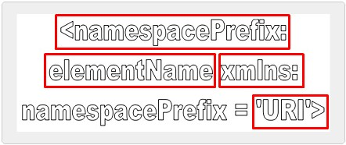
Namespace Syntax 1-3

Slide 11


Namespace Syntax 2-3
NamespacePrefix
Used as a reference to the namespace
Prefixes must not begin with xmlns or xml
ElementName
Specifies the name of the element
xmlns
xmlns stands for XML namespace
URI
URI is a string of characters which identifies an Internet Resource

Slide 12


Placing attributes in a Namespace 1-3
Attributes belong to particular elements
They are not a part of namespace, even if the element is within some namespace
If an attribute has no prefix, it has no namespace
An attribute without a prefix is in default namespace
If an attribute name has a prefix, its name is in the namespace indicated by the prefix

Slide 13

Placing attributes in a Namespace 2-3
Syntax
<Catalog xmlns:Book = “http://www.aptechworldwide.com”>
<Book:Booklist>
<Book:Title Book:Type = “Fiction”>Evening in Paris</Book:Title>
<Book:Price>$123</Book:Price>
</Book:Booklist>
</Catalog>

Slide 14


Placing attributes in a Namespace 3-3
Code Snippet
prefix:localname=’value’ or prefix:localname=”value”
where,
prefix is used as a reference to the namespace. Prefixes must
not begin with xmlns or xml localname is the name of an attribute
value mentions a user defined value for an attribute

Slide 15
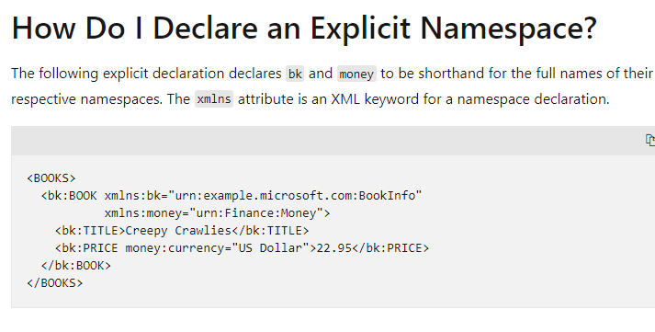

Slide 16
